Slide 1
Supporting your Emergent or Beginner readers
By: Ms. Breanna Wisnor

Slide 2
Choosing appropriate books
When reading aloud to your children, select books that are slightly above their independent reading level. This will challenge them to higher levels of thinking.
Also select a variety of different genres. While your child may already have a favorite style, include a variety of fiction and nonfiction books to deepen their learning and expose them to new ideas.
http://kidshealth.org/parent/positive/all_reading/right_reads.html#

Slide 3
Concepts of print
One of the greatest ways to support your child in becoming a skilled reader is to read to your children early and often! From the time they are born, spend time reading to them daily! This will make a significant difference as they progress into emergent readers. As you read to your child, s/he will develop concepts about print. As they observe you reading, they will learn how to handle the book upright, where the front and the back of the book are, how to read left to right and top to bottom and how to turn the pages as they read. Snuggle up to read! The closer your child, the more authentic the experience. As they get older, help them manipulate the book by allowing them to turn the pages. It is also very important to slide your finger under the text as you read and move from line to line. This will help your child realize print directionality and come to understand that it is the text that portrays the message.
Please note: Your job is to READ to your child, not test them. Make
reading at home an enjoyable experience for you & your little ones.
http://www.education.com/reference/article/concepts-about-print-reading/

Slide 4
Concepts of print Activities
Have a family message board. Write messages about events of the day and read them to your child.
Create lists together so s/he can see you begin writing at the left and write from the top to the bottom of the page. Read each word slowly as you write.
Write letters to loved ones together. Let them dictate as you write. Then read them together.
Make a book together. Allow them to dictate the story as you write. Then have them illustrate the pages!
Download the app “Little Bird Tales” to create your own books on an iPad, tablet or smart phone.
Together write words to wordless books such as Rosie's Walk by Pat Hutchins, The Great Cat Chase by Mercer Mayer, or Peter Spier's Rain by Peter Spier.
http://ccberkshire.org/2013/09/parent-child-home-program/
http://www.education.com/reference/article/concepts-about-print-reading/

Slide 5
Repeated Readings
Most children have a favorite book that they always want to read. I know it can seem redundant as a parent reading the same story every night but repeating readings of the same book often does have many benefits for your young readers. Hearing the same story read multiple times helps improve their fluency and comprehension. The more they hear their favorite stories, the better they will begin to understand the meaning of the text. Once your child begins to read on his/her own, repeated readings of the same text will also improve their reading fluency.
http://nichcy.org/research/summaries/abstract55

Slide 6
Read Poetry to improve fluency
Also consider playing books/poetry readings on tape so that your child can hear a reader reading with great expression and fluency. This is an excellent way to model reading as children will naturally mimic how they heard the story read.
While books on tape are great resources for busy parents, remember that it is still important to read daily to your children. ☺
A great book for children’s poetry:
“Sing a Song of Popcorn: Every Child’s Book of Poems”, selected by Beatrice Schenk de Regniers, Eva Moore, Mary M. White, and Jan Carr (Scholastic, 1988).
Reading poetry will help your beginner reading improve his/her fluency. The fluidity and expression found in the writing style of poems naturally lends itself to be read in a similar way.
To best use poetry at home, begin by reading the poem to the child. Remember to model fluent and expressive reading. They will often mimic the poem as they heard it read.
Read the same poem every night until you child as mastered it.
http://www.readingfirst.virginia.edu/prof_dev/fluency/
section3.html#poetry

Slide 7
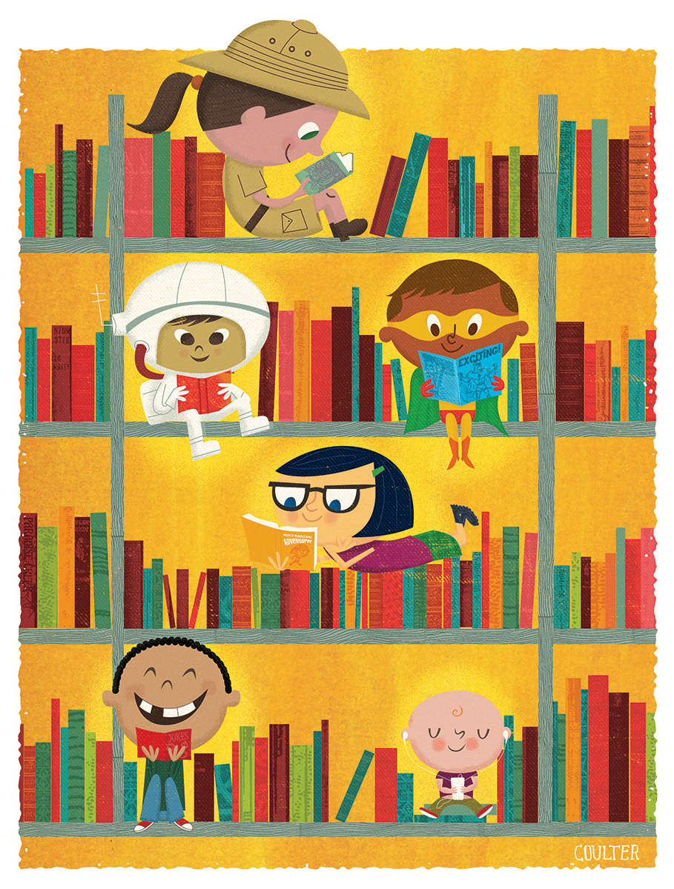
Allow them to retell stories in their own words
Allow your children to retell stories based on memory and illustrations. It is okay that they are not reading the actual words when they are first beginning to read. Allow them to be creative and tell their own story.
It is best if you notice them pointing to the words as they read as this proves that they understand concepts of print.
Other skills improved by retelling stories:
Reading comprehension
Vocabulary
Making inferences
Knowledge of story structure
Understanding the main message/overall theme
http://www.factsinaction.org/classroom/cljul03.htm

Slide 8
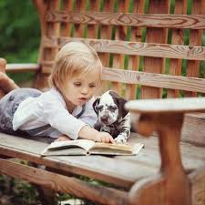
Why Read aloud?
1. To share a loving, educational experience together.
2. To model good reading habits and behaviors.
3. To help prepare your child to be successful readers.
4. To prove that you value reading.
5. To help your child develop positive feelings associated
with reading so they will become life-long reading lovers!

Slide 9
10 read aloud commandments from: mem fox
Spend at least ten wildly happy minutes every single day reading aloud. From birth!
Read at least three stories a day: it may be the same story three times. Children need to hear a thousand stories before they can begin to learn to read. Or the same story a thousand times!
Read aloud with animation. Listen to your own voice and don’t be dull, or flat, or boring. Hang loose and be loud, have fun and laugh a lot.
Read with joy and enjoyment: real enjoyment for yourself and great joy for the listeners
Read the stories that your child loves, over and over, and over again, and always read in the same ‘tune’ for each book: i.e. with the same intonations and volume and speed, on each page, each time.
Let children hear lots of language by talking to them constantly about the pictures, or anything else connected to the book; or sing any old song that you can remember; or say nursery rhymes in a bouncy way; or be noisy together doing clapping games
Look for rhyme, rhythm or repetition in books for young children, and make sure the books are really short.
Play games with the things that you and the child can see on the page, such as letting kids finish rhymes, and finding the letters that start the child’s name and yours, remembering that it’s never work, it’s always a fabulous game.
Never ever teach reading, or get tense around books.
Please read aloud every day because you just adore being with your child, not because it’s the right thing to do.
http://memfox.com/for-parents/for-parents-ten-read-aloud-commandments/

Slide 10
Happy reading ☺
Homework
Visit http://homegrownbooksnyc.com/pages/resources-1
for great videos on appropriate reading strategies.
Take 10 minutes everyday to snuggle up with your little one and
READ!
-Miss Breanna Wisnor

