Slide 1
Welcome to “Once Upon an e-book”
A Presentation on Digital Storytelling
By: Breanna Wisnor
Monday, July 25, 2016

Slide 2
Why is this topic important?
This presentation was created because I know we often struggle to find meaningful activities during our weekly computer lab time. It often feels like “another thing to plan”. We have been told by the third grade teachers that, based on the AIR test, our students need more practice with responding to online writing prompts. When completing a digital storytelling module for my educational technologies course, I came across several meaningful sites to create online books. I think this could be a great way for our students to work on an engaging, ongoing project each week that is meaningful but does not require us to plan.

Slide 3
How will this benefit our students?
The anticipated student need is exposure to typing in a meaningful way. As second graders, students need to practice typing their thoughts in a coherent and meaningful way because there is a great deal of typed, extended response on the third grade AIR test. This past year, third graders struggled with this skill. They were not able to type fast enough and struggled to put their ideas into coherent, typed responses.
-How often did you allow your students to practice typing last year?
-Did you ever use digital storytelling in the classroom?
-How did you help your students prepare for the air test?

Slide 4
How was this need determined?
-Cadre/staff meetings and discussions with first, second, and third grade teachers on preparation for the AIR test. -Discussions with students, parents, and teachers. -Observations of second graders. -Survey Monkey –survey conducted at the end of the 2015-2016 school year.

Slide 5
Goals and Objectives
The goal of this workshop is for teachers to leave with a meaningful activity to use during computer lab time to better prepare second graders for the third grade AIR test.
By the end of this workshop, participants will be able to apply the skills they have acquired from the session to create a mystorybook.com account and sample story.

Slide 6
The look we get when we ask our students to freewrite…
The answer…
http://www.scholastic.com/teachers/story-starters/
Add a comment to this slide to tell me how you would use this website with your students?

Slide 7
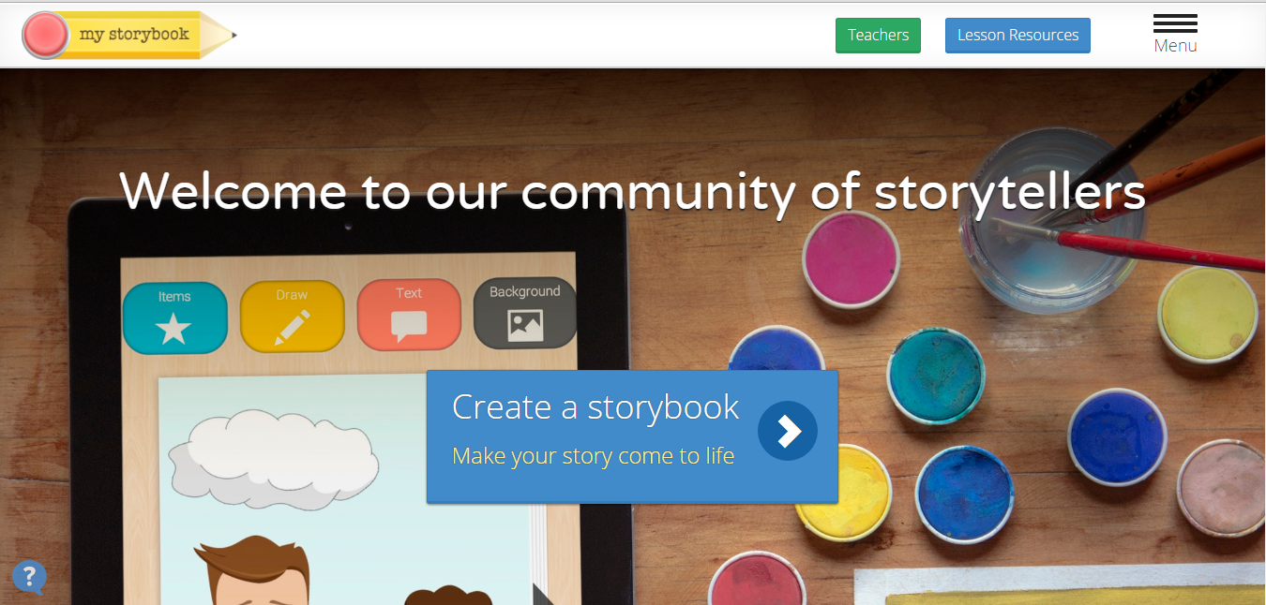
Now for the FUN part! Go to https://www.mystorybook.com/

Slide 8
Let’s debrief
*Will you incorporate digital storytelling into your classroom next year? If yes, how so?
*How is mystorybook.com a useful resource for providing students with a meaningful typing experience?
-We Described how we prepared students for the AIR test and exposed them to typing last year.
-We Explored a new website for brainstorming and discussed how we would use this site in the upcoming school year.
-We Created a story on mystorybook.com to explore a new way of incorporating a meaningful typing experience for students.

Slide 9
INterested in exploring more?
Check out these additional online story creators:
https://storybird.com/
http://www.abcya.com/story_maker.htm

Slide 10
Before you go…
Please click the link below to take a survey on the effectiveness of today’s session:
https://bgsu.az1.qualtrics.com/SE/?SID=SV_emUTTY9yIk9E6eF

Slide 11
References
Images: http://www.candcoedlaw.com/blog/wp-content/uploads/2014/04/Frustrated.jpg
Websites explored:
http://www.scholastic.com/teachers/story-starters/
https://www.mystorybook.com/

