Slide 1
Engagement Video:
http://www.youtube.com/watch?v=Jpvuqj5nv6U

Slide 2
Human Body

Slide 3
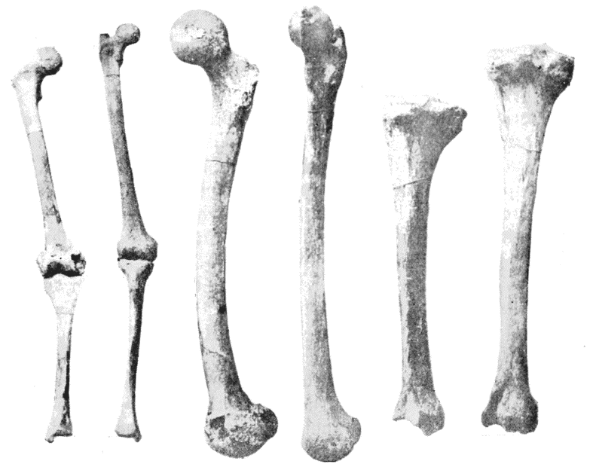
Bones
Bones hold your body up. It is like a supporting structure of your body.
These are leg bones..

Slide 4
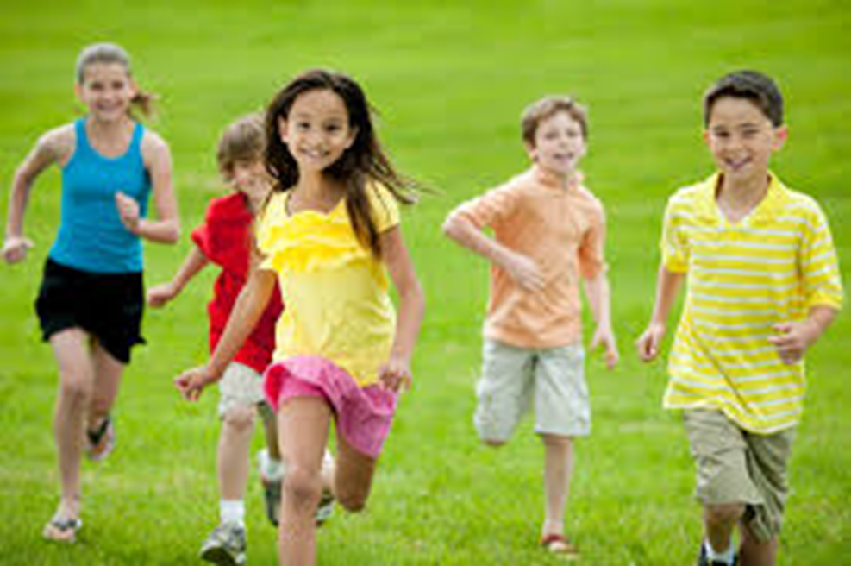
Feel the bones in your legs. Feel the short bones in your fingers. Your bones and muscles work together to help you move.

Slide 5
Can you see your bones ?

Slide 6
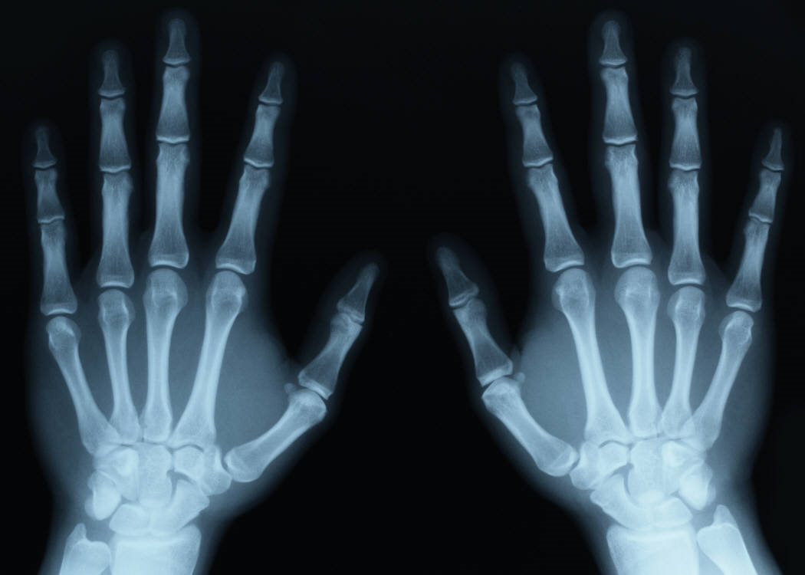

Slide 7
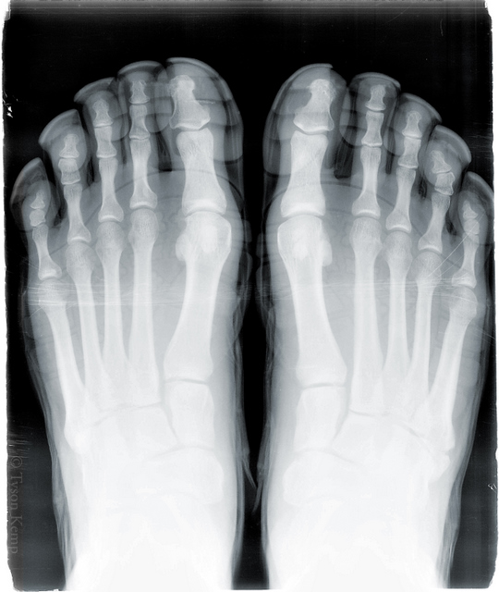

Slide 8
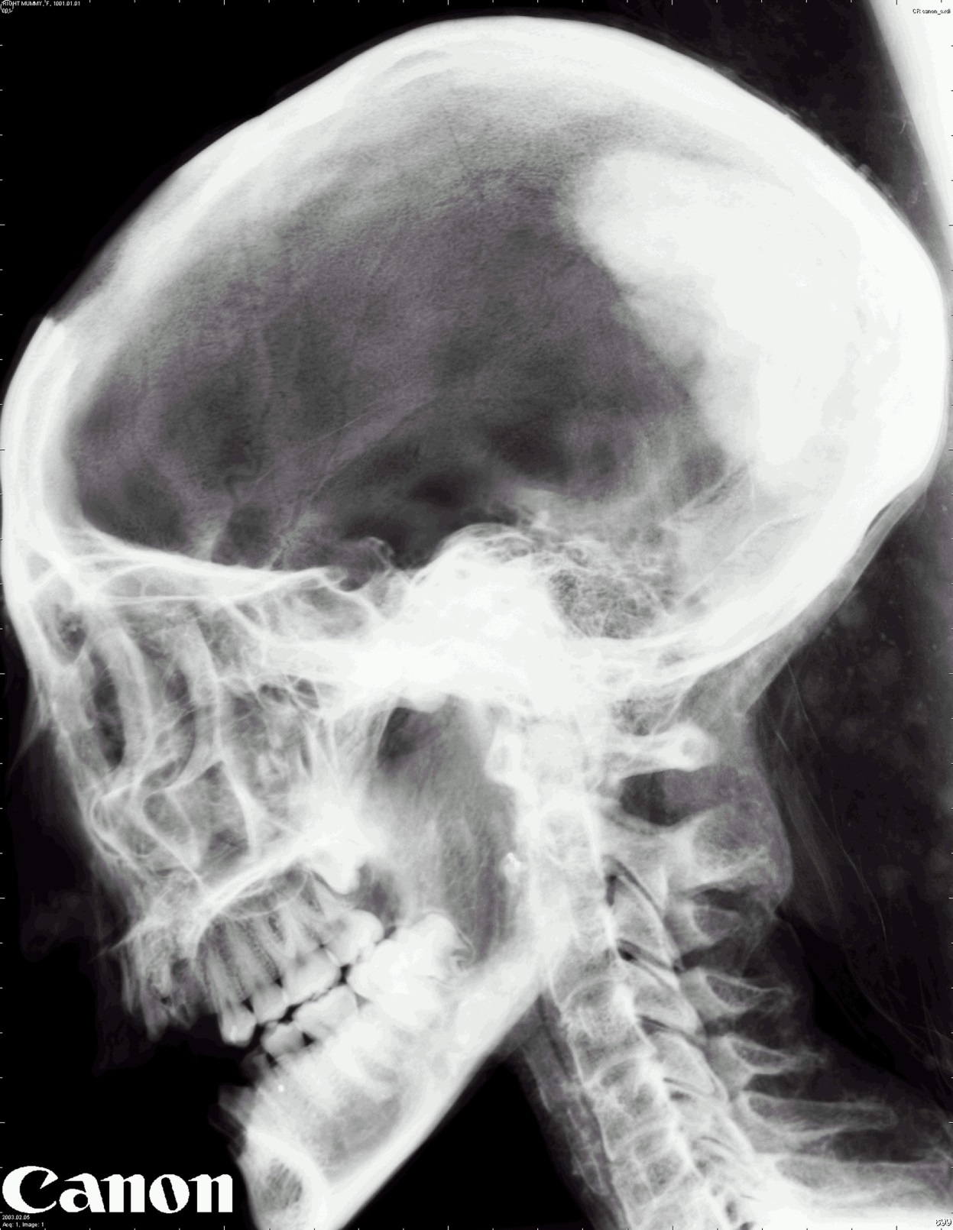

Slide 9
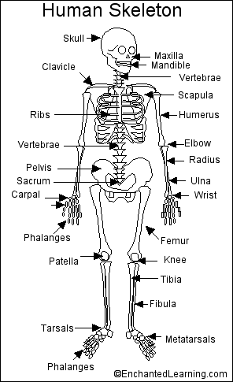

Slide 10
Do you know how many bones you have ?

Slide 11
There are 206 bones in the adult human body.

Slide 12
What is the largest
bone in the human
body?

Slide 13
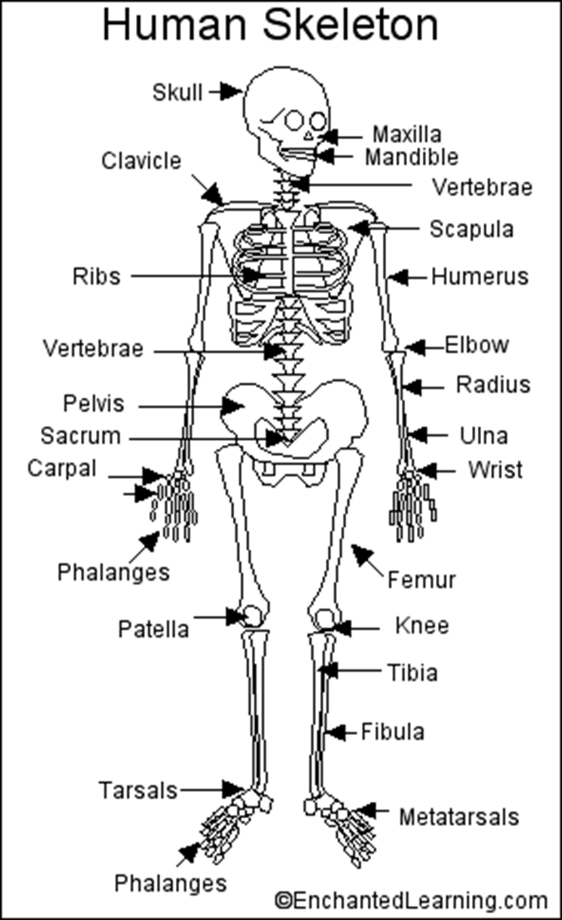

Slide 14
What is the
smallest bone in
the human body ?

Slide 15
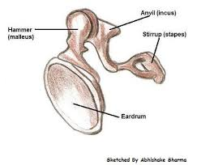
It is the stirrup bone inside the ear.

Slide 16
http://www.youtube.com/watch?v=_RHZZ-71SxM

Slide 17
Your muscles cover your bones. It is imortant to keep your muscles healthy by excerising and stretching.

Slide 18
There are 650 muscles in the human body. They are joined to bones with tendons.

Slide 19
The largest muscle in the human body is the gluteus maximus.

Slide 20
There are 40 muscles in your face. Your face uses 50% more muscle to frown than it does to smile. That’s a great reason to smile more often ☺

Slide 21
