Slide 1
By: Breanna Wisnor

Slide 2
What is Fundations?
Originally designed to help illiterate adults learn to read, the program is an intensive, research based approach. Fundations is a system that bridges phonics and literacy skills for students in grades kindergarten through second grade. Fundations provides a foundation for reading and spelling. It is a structured, sequential, and cumulative phonics/spelling program using multisensory teaching techniques. The Fundations program is common core aligned with reading, writing, speaking, listening, and language standards.

Slide 3
Skill Development
The following skills are developed in a carefully structured scope and sequence:
Letter formation
Phonological and phonemic awareness
Sound mastery
Phonics
Vocabulary
Irregular (trick) Word Instruction
Fluency
Comprehension
Written composition
http://www.fundations.com/overview.aspx

Slide 4
Highlights of Fundations
Emphasis on systematic phonics and study of word structure
Skills taught explicitly and systematically
Instruction is cumulative and scaffolds presented skills
Teachers model with “Echo” the owl puppet directing students to repeat sounds, words, and sentences
Assessments monitor students throughout the program
The manual provides direction for support staff to meet individual student needs
Extensive practice provides multiple opportunities for skills application
Home Support Packet encourages parental involvement
Fundations stories and readers meet or exceed Lexile® text measures for each grade.
http://www.fundations.com/overview.aspx

Slide 5
Fundations Research
http://www.fundations.com/pdf/Fundations%20Overview%20and%20Studies%20of%20Program%20Effectiveness.pdf

Slide 6
A Closer look at a daily lesson
Fundations in the regular education classroom.

Slide 7
Drilling Sounds with Baby Echo
Basic Keywords
Vowel Sounds

Slide 8
Drilling Sounds with Baby Echo
R-Controlled Sounds
Vowel Teams

Slide 9
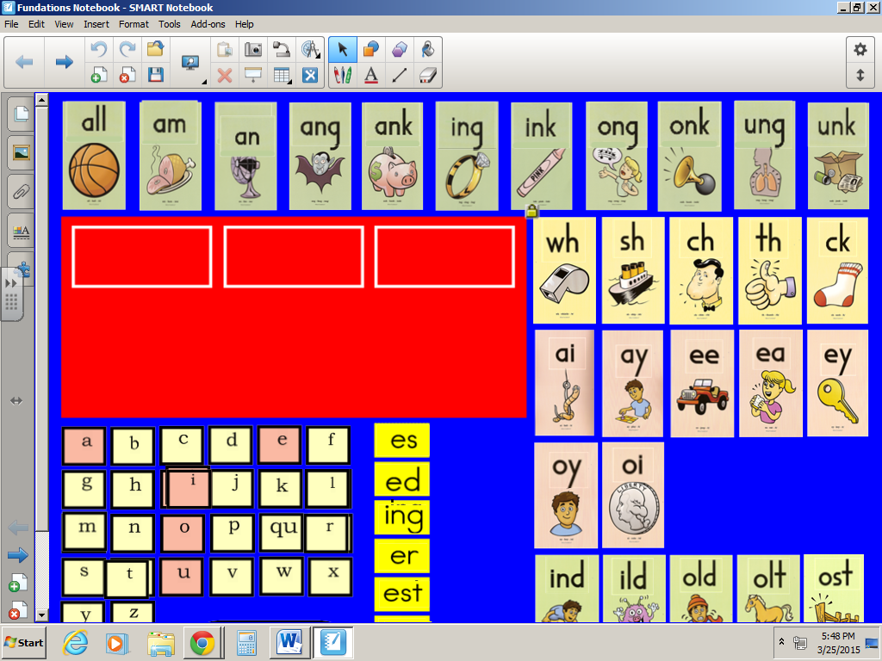
Fundations on Smart Notebook

Slide 10
Marking Up!

